Slide 1
Dr Paul Allen
Queen Mary University of London

Slide 2
The Application: Designing your project
Grounded on previous research
Know what’s being done in the area already
Consider a logic model
Be able to explain why you have rejected alternative study designs

Slide 3
The Application: Must Haves
Prove your research question is important
Demonstrate that conducting your project is feasible
Methodological expertise
All bases covered
Underpinning theory
Conceivable that the intervention could be disseminated within the NHS

Slide 4
Tips on writing the application
Follow the instructions closely
Pay attention to each bit of the form
See if a colleague will share a recent successful application to the same funding stream
Circulate around your group
Get peer review
Get support from RDS
Lay summary really important
What are your weak spots? Address them!
Be kind to your reviewers – think about layout , clarity, subheadings

Slide 5
Research Environment
All the facilities to do the project
Patients
Expertise
Backup staff
Ethics
Supervisors, number of, training status, contribution of each supervisor to the project.

Slide 6
The Supervisor
The responsibilities of supervisors, and students, are set out in the College’s Code of Practice for Research Degrees Programmes.
A clear supervision plan is central to a student’s progress.
Supervisions to take place regular intervals.

Slide 7
The Supervisor
Queen Mary’s model
Student should use the Supervision Log on to keep a written record of their supervisions with the supervisor – this records the date and format of each supervision, and includes a box where they can record notes from the supervision. They can also use the log to attach files (e.g. chapters of the thesis) for you to read. Once completed, SITS will generate an email asking you to review and approve the notes, at which point you can ask for them to be revised (adding thoughts of your own) or approve.

Slide 8
Supervisor
A minimum of 10 meeting logs must be submitted per year.
You may also see a record of all previous supervisions with your student, and of notes relating to supervisions they have had with another member of the supervisory team, on the Approved Supervision Notes Table.

Slide 9
Supervisor
Good feedback is essential to good progress.
Supervisors should discuss in advance with their student what form of feedback they will be giving at different stages of their project.
It is especially important to agree what form of feedback will be offered for written work.
Consider:
What stage of work am I prepared to offer feedback? (1st, 2nd or 3rd drafts?)
How many drafts am I prepared to read of each chapter?
What work is best responded to verbally, what with written comments?
What form will written comments take?
What do I need to know about the wider context before I read each piece?
When student’s have writing problems, whose responsibility is this?
Good feedback often consist of 3 elements: Strengths, Weaknesses, Ways of Improving

Slide 10
Supervisor
The supervisor is responsible for monitoring their student’s engagement with training and ensuring they complete the minimum each year
RCUK expects all PhD students to undergo 210 hours of training/development during their PhD
Supervisors should therefore regularly audit their student’s training needs

Slide 11
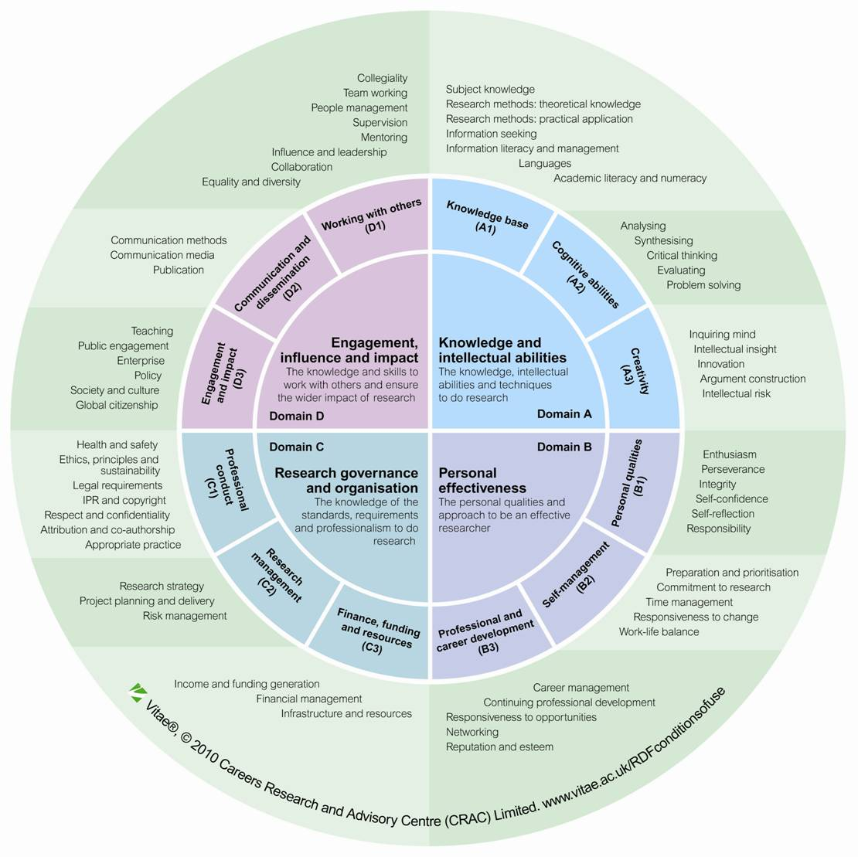
www.vitae.ac.uk

Slide 12
Host Institution
Research Environment.
Critical Mass (student numbers). In the School, in the institute/department, on the unit.
Active recruitment…..give numbers per annum.

Slide 13
Host Institution
Prestige
Other funding stream (MRC, BBSRC, EPSRC, CRUK, Wellcome, NC3R programmes)
Percentage research students/ECRs on REF returned papers (REF14).
Postgraduate Research Experience Survey (PRES) data.

Slide 14
Host Institution
Academic Rigor
Progression milestones e.g. 9 months, 18 months, 30 months
Expected submission date in accordance with Vitae and Research Councils UK recommendations (within 48 months)
Expected completion date.

Slide 15
Host Institution
Supervisions; minimum number, when, frequency.
Record what is said and how is this recorded (online)
Level of feedback from supervisors (1st draft, 10th draft?!)
Training available. How much (hrs). Who provides it. e.g. Researcher Development Unit.
Induction days
Cohort days
GradFest or equivalent.

Slide 16
Host Institution
Students Well Being and Welfare
Networking events, social events
Open seminars.
Junk the Jargon
Café Scientifique
Profession Services: Support and Counselling, Student Health Service
Equality and Diversity awareness.

